Slide 1

Department of Geography
GEOG0114: The Principles of Spatial Analysis
Notes:
Welcome everyone, my name is Anwar Musah.
I am a Lecturer in Social Geographic Data Science within the Department of Geography.
I am the convenor for this module titled: “Principles of Spatial Analysis”. I will be teaching this course jointly with my dear colleague, Dr Justin van Dijk, who is also a Lecturer in Geography Department.
… and the purpose of this video is to give you an overview of this course and what its about, and to talk about some of the interesting topics will teaching, as well as the kind of skills you will acquire – which are in high demand in academia and the many sectors in industry. So, let’s begin…

Slide 2
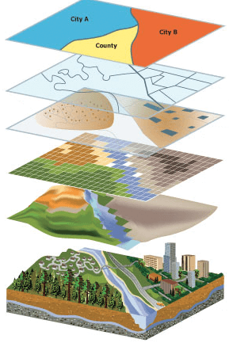
Department of Geography
Aims of Module
Broadly, the following learning outcomes:
To introduce you to key principles of spatial data
Provide an introduction and knowledge of methods for exploring various types of spatial data (i.e., point, areal, line segments and gridded/pixeled data)
You will know how to adopt various spatial analytical techniques for testing out hypothesis, and for addressing problems related to social phenomena and its spatial components.
You will learn to how to apply various families of spatial models (e.g., geographic weighted regressions, Global & Local Moran’s I, Kriging and many more) for making spatial predictions and studying patterns of associations between risk factors and outcomes
You will gain programming skills for carry out data managing, geoprocessing and analysis of spatial data using the software package R/RStudio. You will gain expert knowledge on how to use R/RStudio as a GIS software to perform high-level map visualization
Notes:
What exactly do we mean by “Principles of Spatial Analysis” in a nutshell?
Introduce to the fundamentals, as well as the key principles, theory and tenets of spatial statistics (and/or) analysis. These will cover:
The various spatial data types
How to geo-process such data (aka handling of spatial data)
How to implement various spatial analytical methods for assessing spatially-referenced areal, point and raster dataset
And using these techniques ultimately for evidence-based research
Think of it as an interdisciplinary subject which brings together statistics, computer science, GIS and research methodology to address social geographical problems, and for determining quantitatively occurrences, or relationships (or interactions) that exists for an outcome – this can be applied from social science, public health, or even from a disaster risk science perspective.
So, this what we mean by “Principles of Spatial Analysis”, and on this module you will learn…

Slide 3

Department of Geography
Module Content
1.) Learning the basic key concepts of spatial data, and using R as GIS for visualization, and theory
Week 1: Introduction to Spatial Analysis for Data Science Week 2: Graphical Representation Week 3: Spatial Dependence and Autocorrelation 2.) Foundational concepts for point and raster-based analysis Week 4: Analytical Hierarchy Process (AHP) Week 5: Ecological Niche Modelling Week 6: Geostatistical Analysis using Kriging
3.) Specialised spatial analytical techniques Week 7: Geodemographics Week 8: Transport Network Analysis 4.) Spatial modelling for inferential statistics Week 9: Spatial Lag and Error Multivariable Regression Models Week 10: Geographically Weighted Regression (GWRs) Models
Notes:
The overarching structure of the course is as follows –
The course is split into 4 segments: in the first 3 weeks covers the foundational theory of spatial analysis. These fundamentals will be encapsulated in the content of week 1 to 3.
The second part, from weeks 4 to 6, you will learn point and raster-based analysis.
You will learn various spatial analytical techniques which are highly specialised with have real world applications, which is encapsulated in the content of week 7 and 8.
Lastly, we will teach you the basics of building spatial models for determining statistical relationships and prediction. These will be covered in the final weeks.
This course is indeed be a combination of lectures and computer practicals whereby you will be trained to use RStudio. The module is designed to have a large practical component; therefore, the coursework will be based on a spatial data analysis programming project where you will be task with using RStudio to perform these analysis and complete a report.

Slide 4
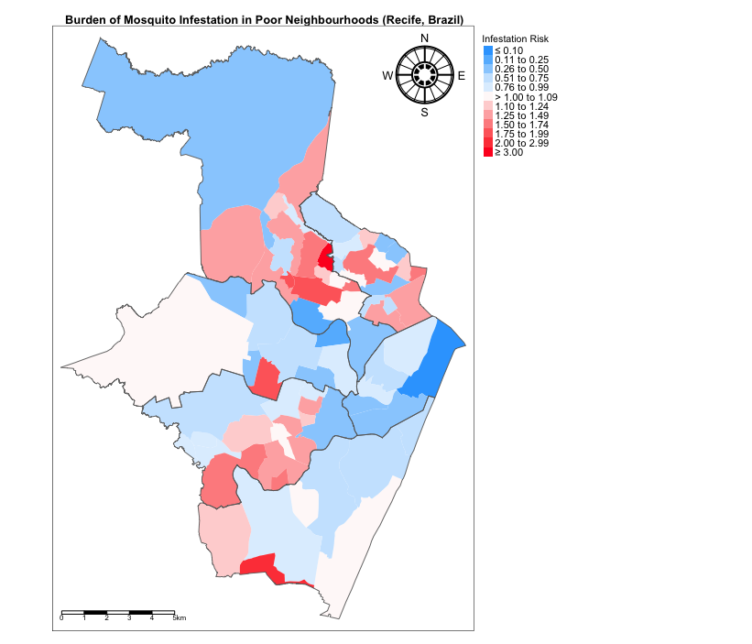
Department of Geography
Example 1: Key concepts & basics of visualizing spatial data
# comment: set directory to folder location of spatial datasets setwd(”~/Documents/Work/Afrimapr Community") # comment: activate packages for performing GIS in R library("sf") library("tmap") # comment: add neighbourhood shapefile w/mosquito infestation data using read_sf() recife.neighbourhoods <- read_sf("Recife_neighb_epsg3857_fixed.shp") recife.healthzone <- read_sf("Recife_regions_epsg3857_fixed.shp") # comment: assigning labels for the risk estimate legends RiskCategorylist <- c(”\u2264 0.10", "0.11 to 0.25", "0.26 to 0.50", "0.51 to 0.75", "0.76 to 0.99",">1.00 to 1.09", "1.10 to 1.24", "1.25 to 1.49", "1.50 to 1.74", "1.75 to 1.99", "2.00 to 2.99", ”\u2265 3.00") # comment: generating the divergent color scheme from Blues to Red spectrum RRPalette <- c("#33a6fe", "#65bafe", "#98cffe", "#cbe6fe", "#dfeffe", "#fef9f9", "#fed5d5", "#feb1b1", "#fe8e8e", "#fe6a6a", "#fe4646", "#fe2424", "#fe0000") # comment: map of risk of infestation tm_shape(recife.neighbourhoods) + tm_fill("RelativeRiskCat", style = "cat", title = "Infestation Risk", palette = RRPalette, labels = RiskCategorylist) + tm_shape(recife.healthzone) + tm_polygons(alpha = 0, border.alpha = 0.90) + tm_layout(frame = TRUE, main.title = "Mosquito Infestation in Neighbourhoods (Brazil)", main.title.size = 0.8, main.title.position = 0.02, main.title.fontface = 2, legend.outside = TRUE, legend.outside.position = "right", legend.title.size = 0.8, legend.text.size = 0.7) + tm_scale_bar(position = c("left", "bottom")) + tm_compass(type = "radar", show.labels = 2, position = c("right", "top"))
Notes:
Just to give you an example – at the end of the module –

Slide 5
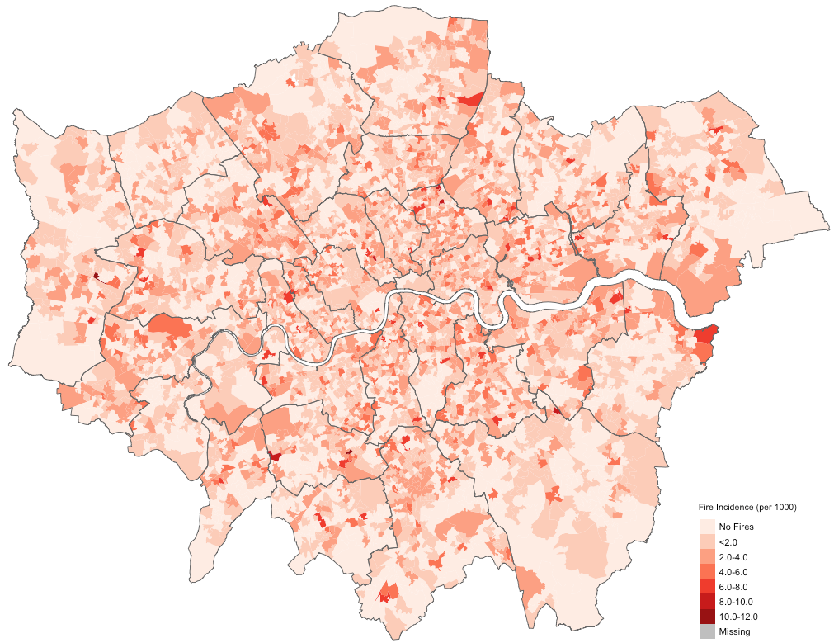
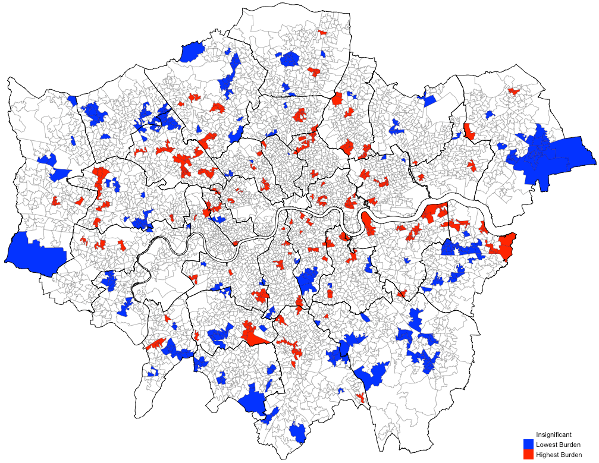
Department of Geography
Example 2: Spatial autocorrelation and exploring patterns of clustering
Determining the location of residential-related fire hazards across postcodes in London, and those which show the highest or lowest burden
Notes:
Just to give you an example – at the end of the module –

Slide 6
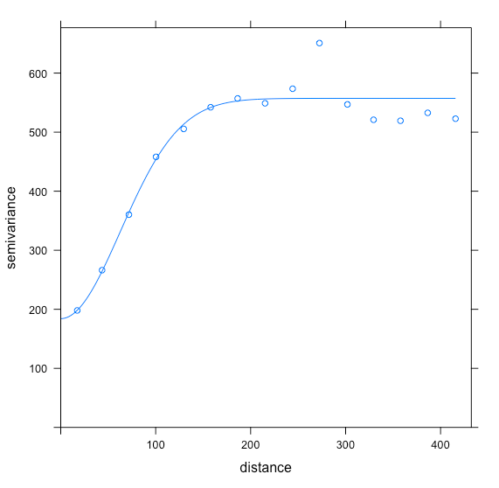
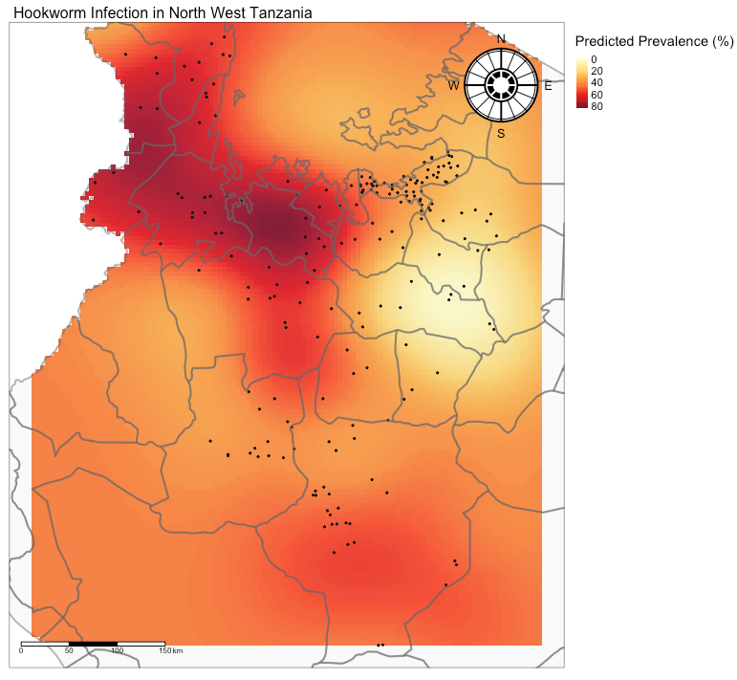
Department of Geography
Example 3: Geostatistics and raster data analysis
Using Kriging to spatially predict areas with intense hookworm infection associated with socioeconomic deprivation in Northwestern Tanzania
Notes:
Just to give you an example – at the end of the module –

Slide 7
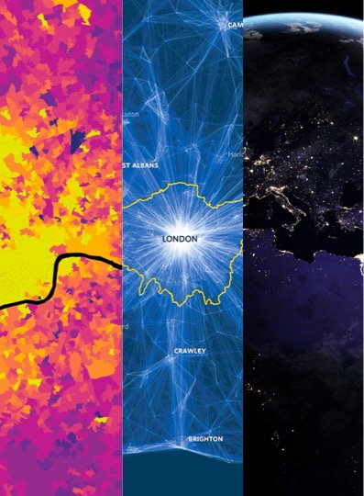
GEOG0114: The Principles of Spatial Analysis
a.musah@ucl.ac.uk
Notes:
I hope this video useful introduction. If you have any questions, please feel free to send me an email me at: a.musah@ucl.ac.uk
Thank you, and I look forward to meeting you!

